Slide 1
Summer Internship Project
Title-Online Joint Seat Allocation

Slide 2
Content
Introduction to NIELIT
Brief Description of the Project
What is DBMS?
Backend of Project with MS-SQL
Front End with MS-Visual Studio

Slide 3

NIELIT
National Institute of Electronics & Information Technology (NIELIT) is an Autonomous Scientific Society under the administrative control of Ministry of Electronics & Information Technology (MoE&IT).
At present, NIELIT has forty(40) offices located in different states. I did my training at the Chandigarh branch of NIELIT under Mrs. Anita Budhiraja (Assoc. Director at NIELIT, Chd.)
NIELIT Chandigarh is currently handling various government projects out of which the latest one is Admission to Class XI in Government School of Chandigarh Administration.

Slide 4

ONLINE JOINT SEAT ALLOCATION
This project work entitled ‘ONLINE JOINT SEAT ALLOCATION’ has been designed to allocate seats to students who have cleared JEE.
Allocating seats manually on such a large scale is quite a hectic task and as the modern organizations are automated and computers are working as per the instructions, it is better to use such technology for such large computations.
Online Joint Seat Allocation is a project which aims in developing a computerized system to allocate seats to students based on their JEE Main and Adv. Ranks .

Slide 5
ONLINE JOINT SEAT ALLOCATION
Highlighting Features of the project:
The facility of viewing the Seat Matrix of different institutes on a single page.
Filling preferences and accepting seat online on the date of result.
The project is developed in two halves, the first half involves the back-end which is designed using Microsoft SQL Server Management Studio. This software helps in GUI view of the tables developed in back-end and gives us many features like editing and generating scripts which helps in easy designing. The second half, front-end to be specific, has been designed using Visual Studio. A basic knowledge of DBMS is required for this project.

Slide 6
Basics of DBMS
DBMS is a collection of inter-related data and set of programs to store & access those data in an easy and effective manner.
It has various models and currently the most used is the relational model of DBMS that is RDBMS.
The basic structure of data in the relational model is tables. All the information related to a particular type is stored in rows of that table. Hence, tables are also known as relations in relational model.
A sample table to store name, age and gender of students
Column1 | Column2 | Column3
Name | Age | Gender
Abhishek | 20 | Male
Anita | 22 | Female
Rupinder | 19 | Male
Sukhdeep | 20 | Male

Slide 7

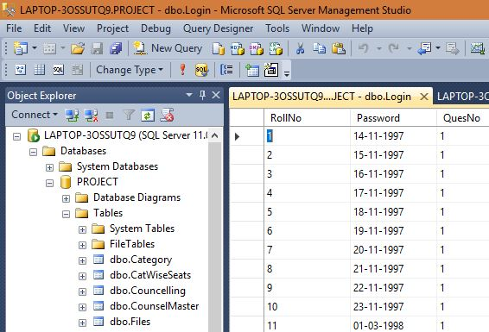
MS-SQL
MS SQL Server is a relational database management system (RDBMS) developed by Microsoft. This product is built for the basic function of storing retrieving data as required by other applications. It can be run either on the same computer or on another across a network. It can be used to create and restore data, create login and backup, assign permissions, etc.

Slide 8
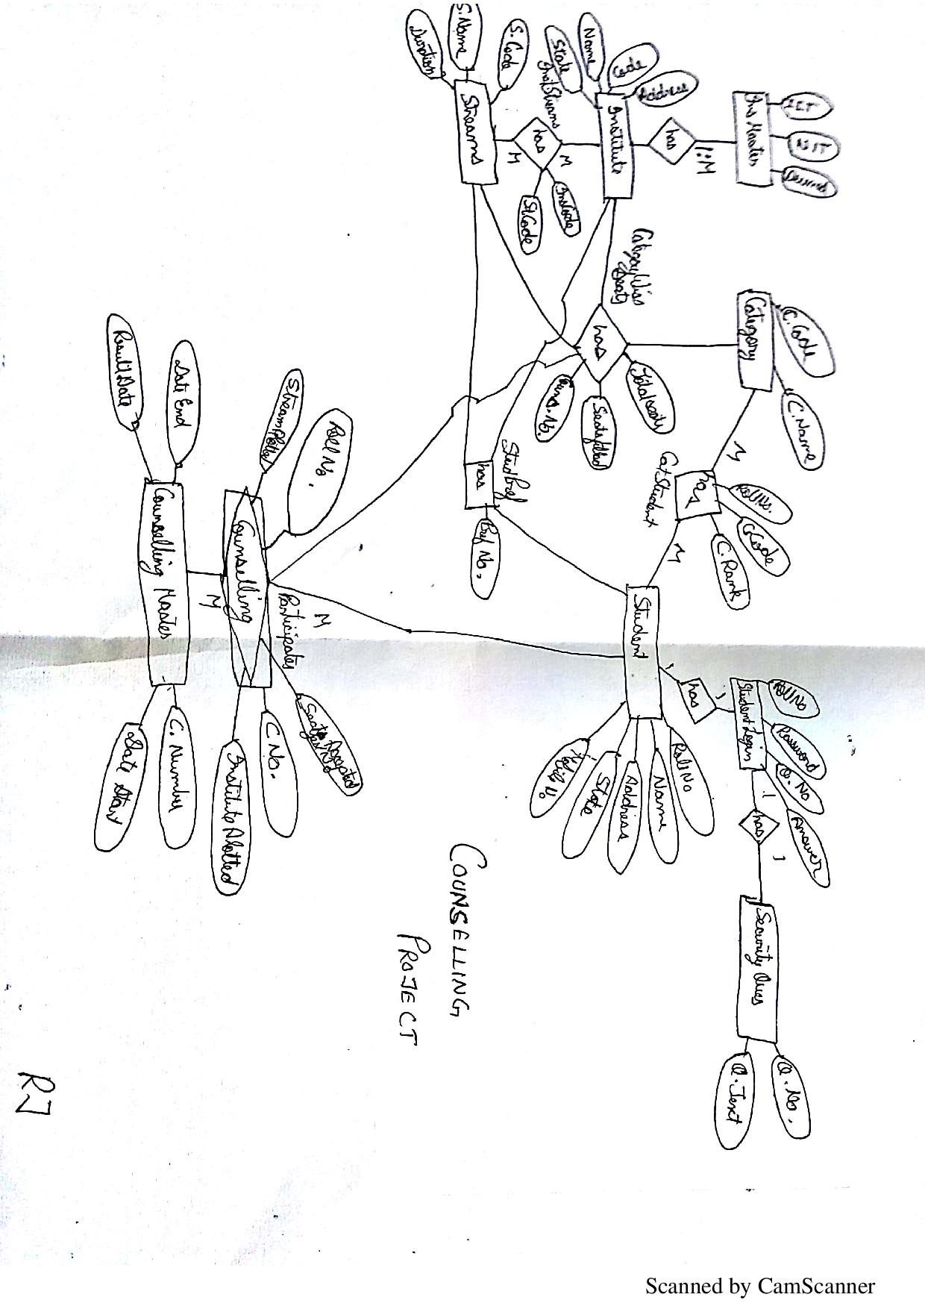
Back-End Layout
Table
Columns
Relation

Slide 9

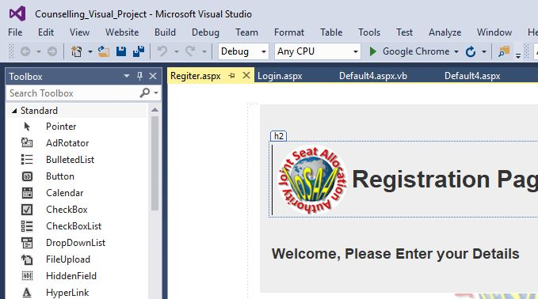
MS Visual Studio
The Visual Studio integrated development environment is a creative launching pad that you can use to edit, debug, and build code, and then publish an app. An integrated development environment (IDE) is a feature-rich program that can be used for many aspects of software development. Over and above the standard editor and debugger that most IDEs provide, Visual Studio includes compilers, code completion tools, graphical designers, and many more features to ease the software development process.

Slide 10
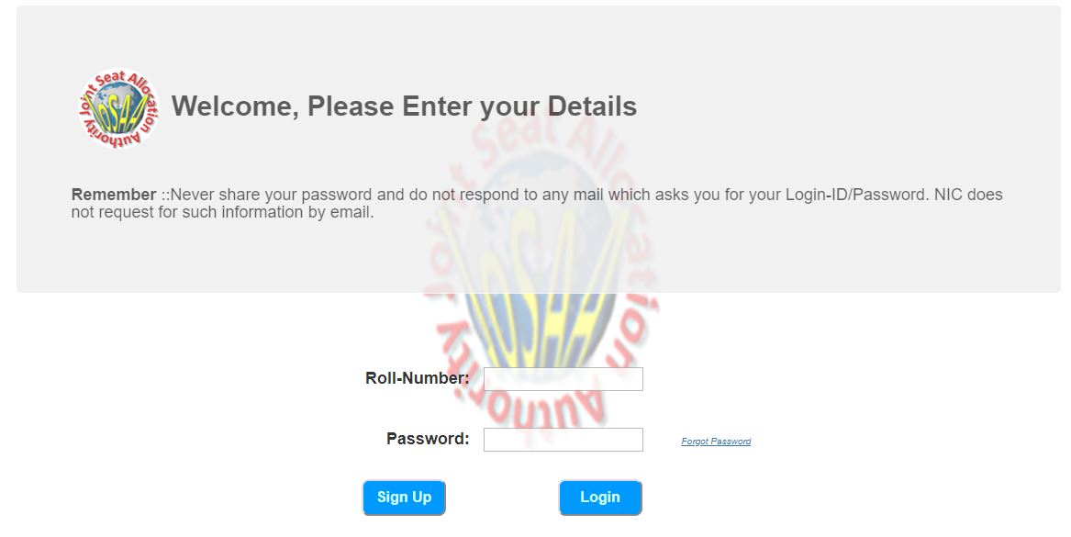
Front-End Walk-through
This is the login page.
Here the registered student enters his details to enter the website.

Slide 11
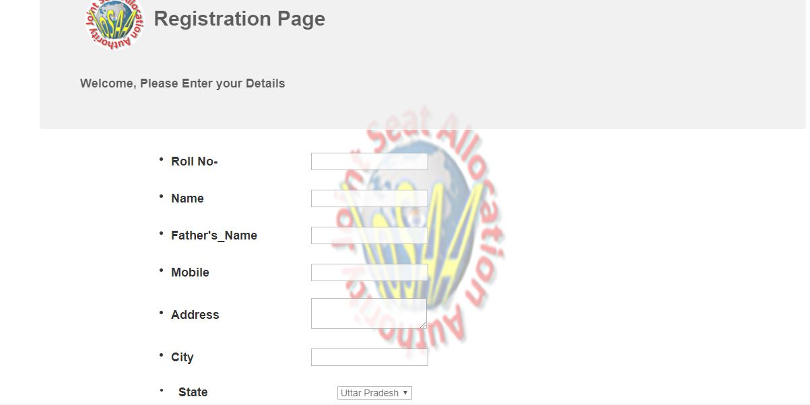
Front-End Walk-through
This is the registration page.
Here the new students can enter their details and register for counselling.

Slide 12
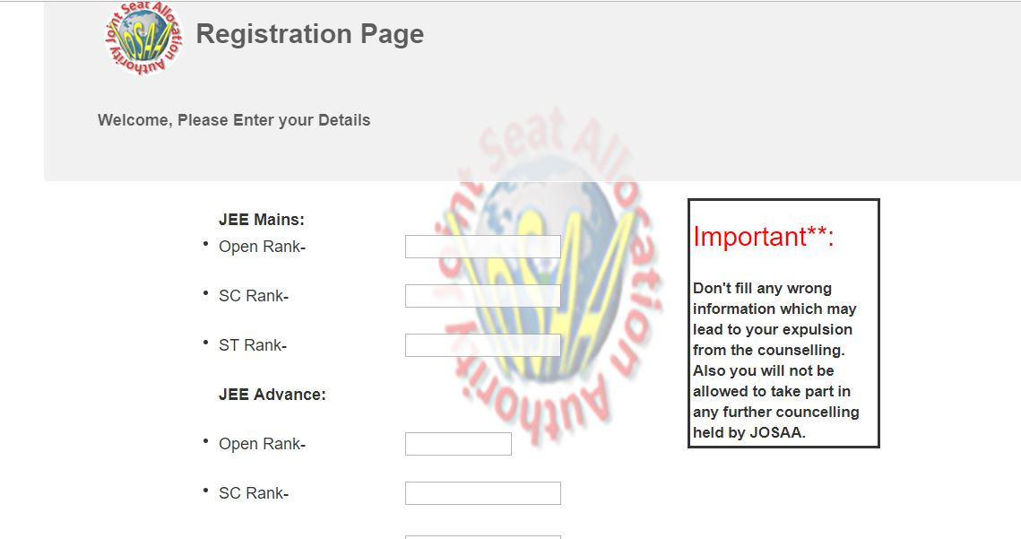
Front-End Walk-through
This is another part of registration page.
Here the registered student enters his ranks obtained in JEE exam.

Slide 13
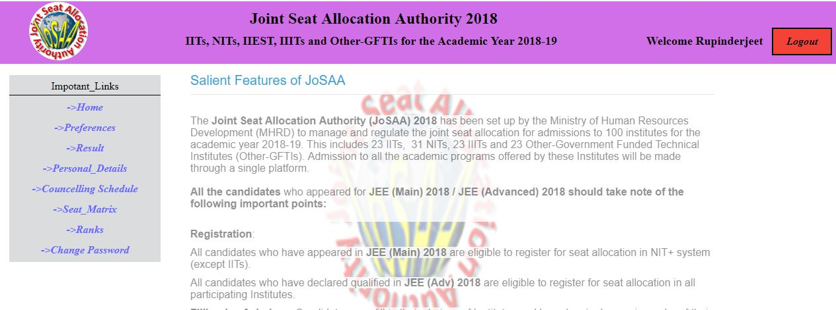
Front-End Walk-through
This is the home page.

Slide 14
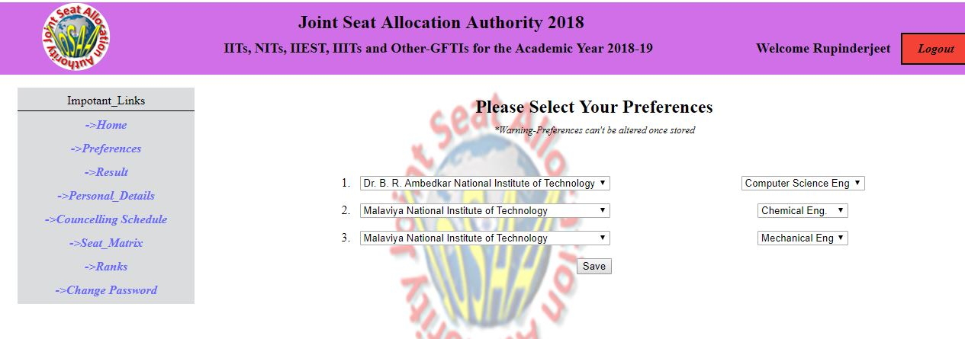
Front-End Walk-through
Here student enters his preferences.

Slide 15
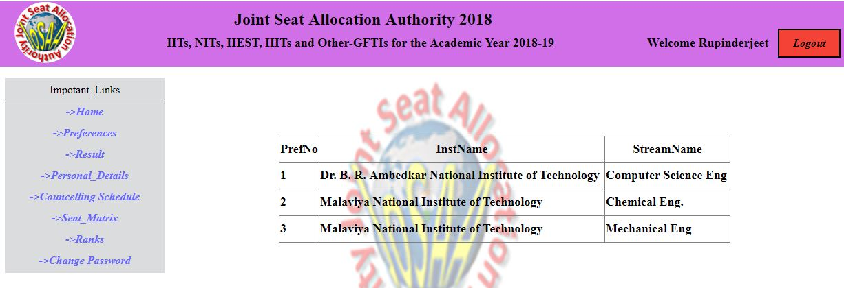
Front-End Walk-through
The saved preferences are shown.

Slide 16
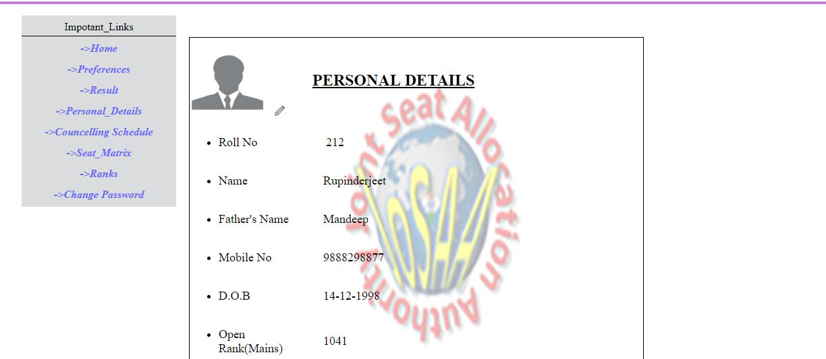
Front-End Walk-through
Here student can see his details.

Slide 17
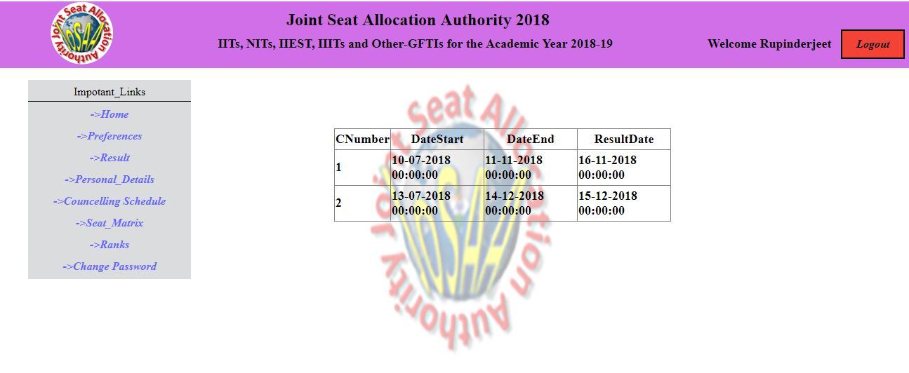
Front-End Walk-through
Here student can see dates of counselling.

Slide 18
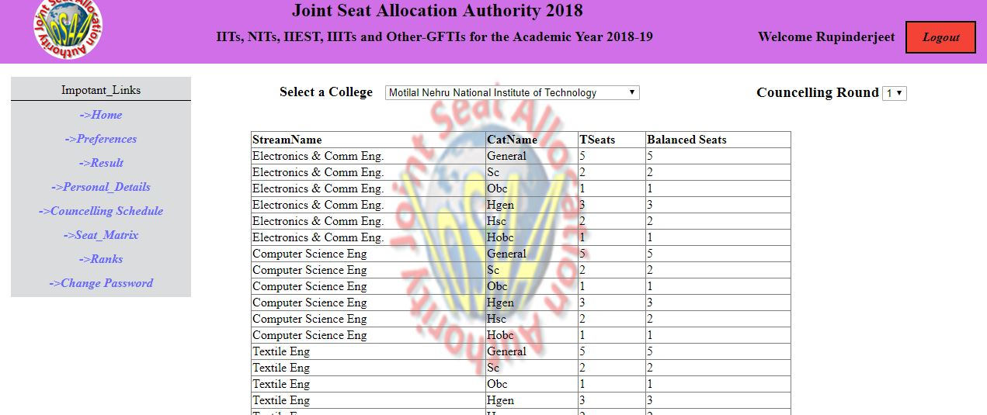
Front-End Walk-through
Here student can see the available seats in various colleges.

Slide 19
Thank You

